Slide 1
AI Your New Employee

Slide 2
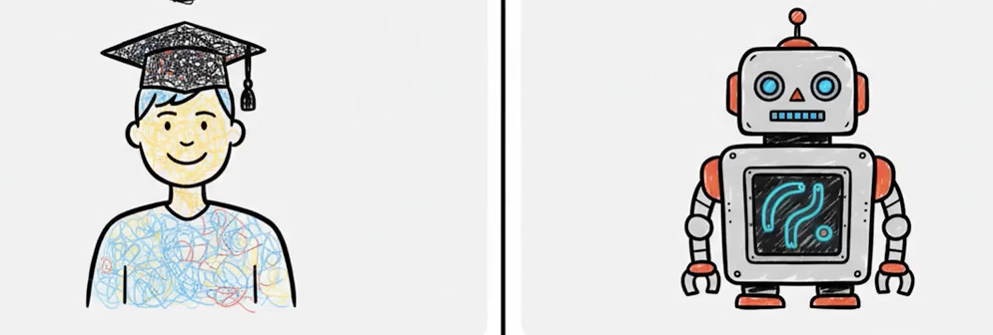
Skilled
Competent
Intelligent
Useless

Slide 3
Learn

Slide 4
Amnesia

Slide 5
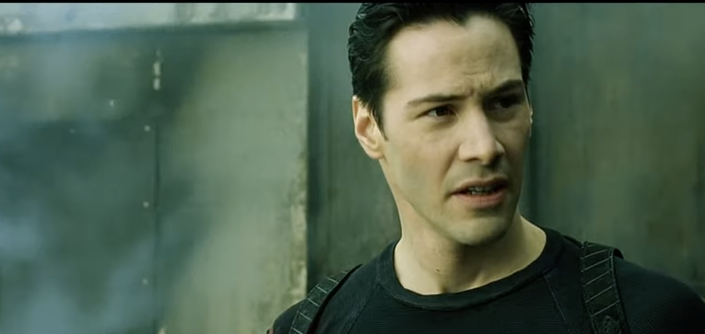
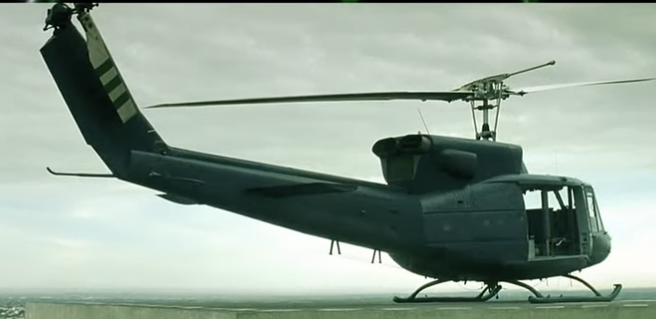

Can you fly that thing?
Not yet…

Slide 6
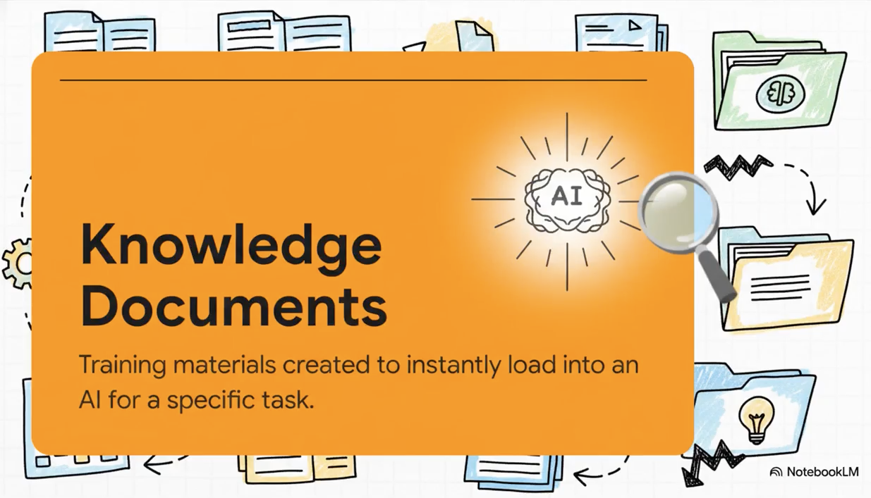
Can you fly that thing?
Not yet…

Slide 7

You are the operator

Slide 8
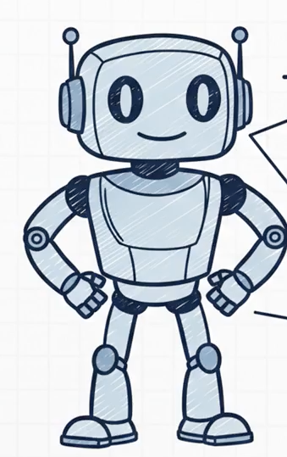

Knowledge
Documents

Slide 9
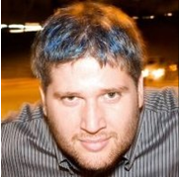
Thank YOU (please connect via LinkedIn and Twitter)
@LlewellynFalco
youtube.com/isidoreus
LlewellynFalco.Blogspot.com approvaltests.com

